Slide 1
Outline
SQL Aliases
SQL Aggregate Functions

Slide 2
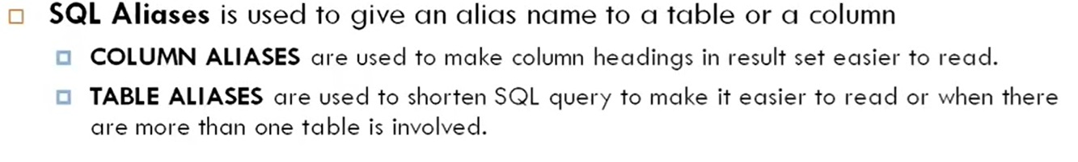
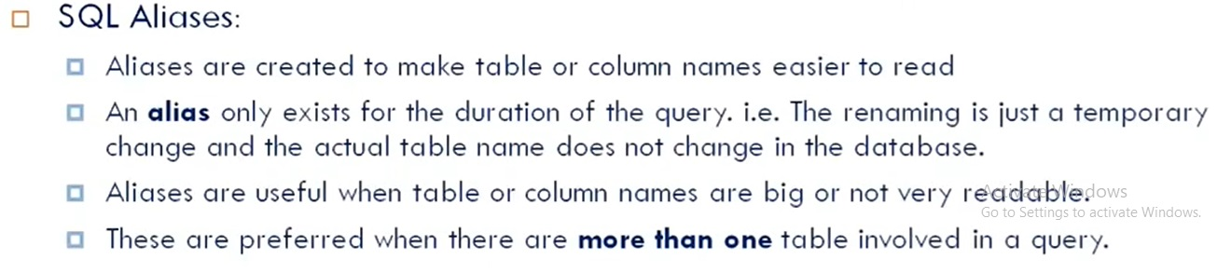
SQL Aliases

Slide 3
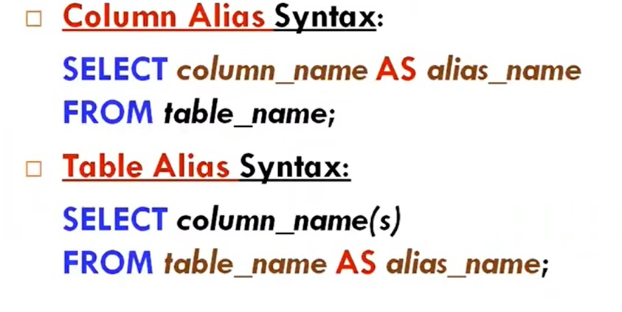
Syntax : SQL Aliases

Slide 4
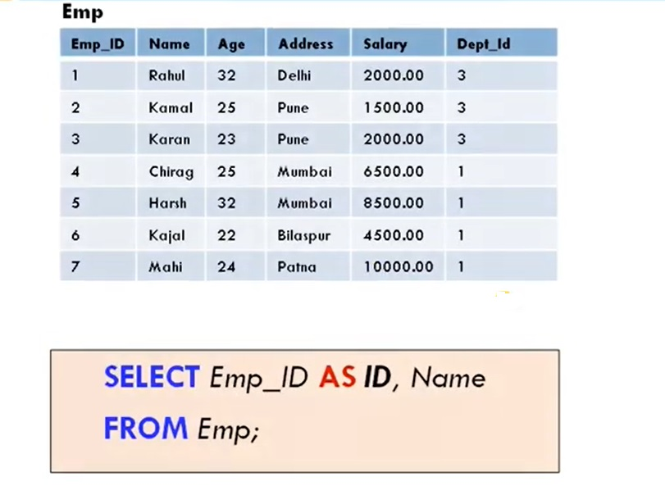
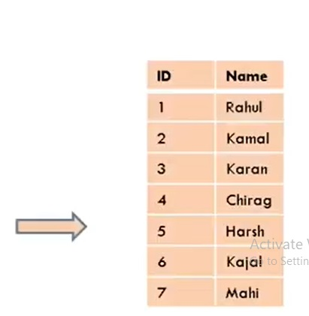
Example : SQL Aliases

Slide 5
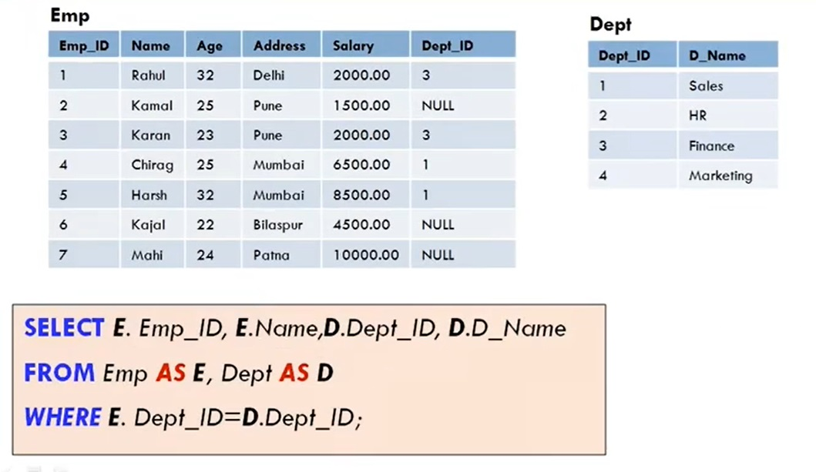
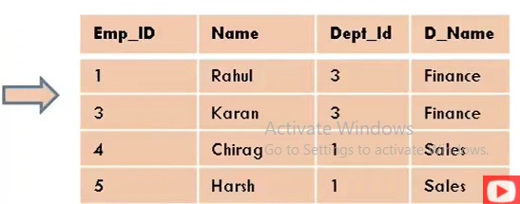
Example : SQL Aliases

Slide 6
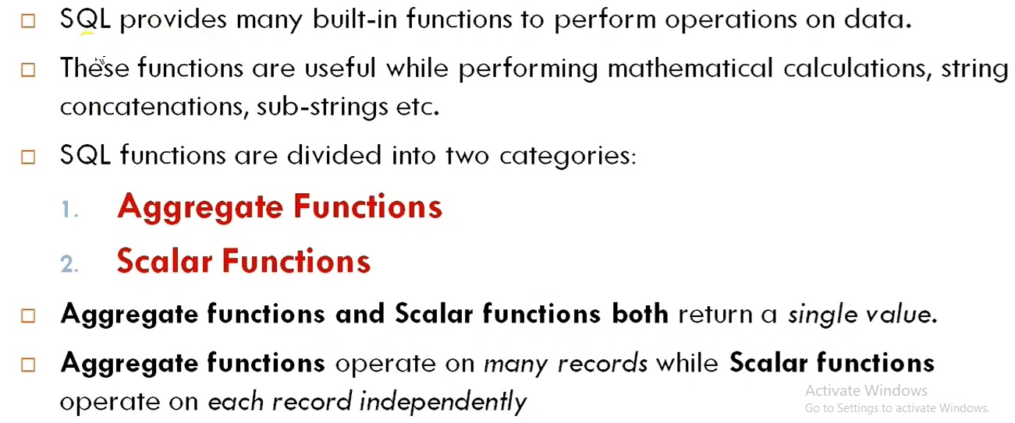
SQL Functions

Slide 7
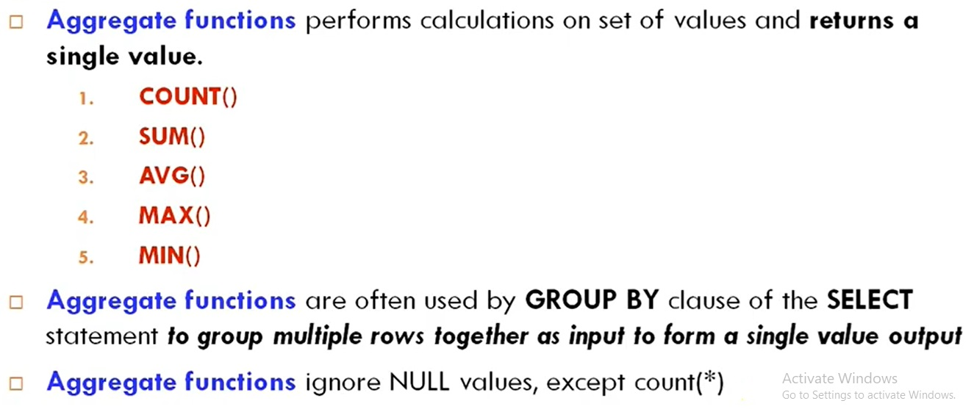
SQL : Aggregate Function

Slide 8
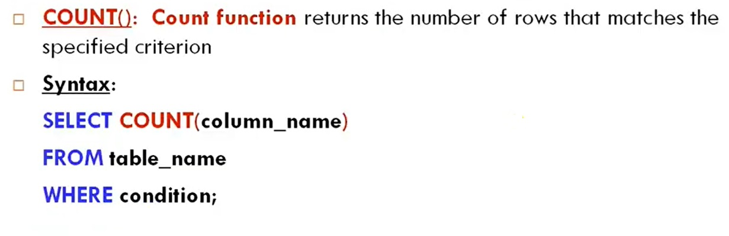
Count Function

Slide 9
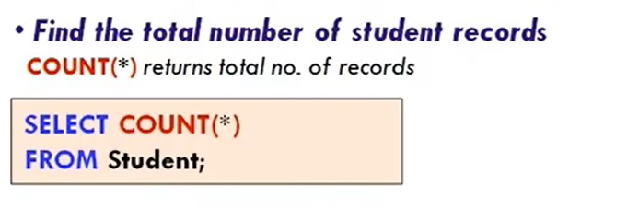
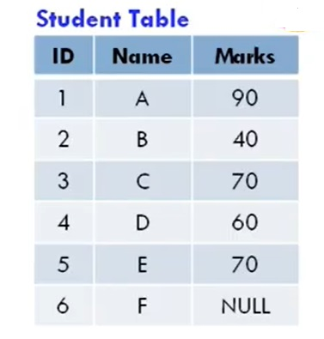
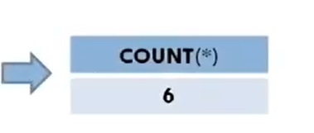
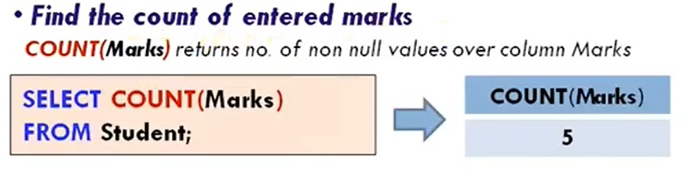
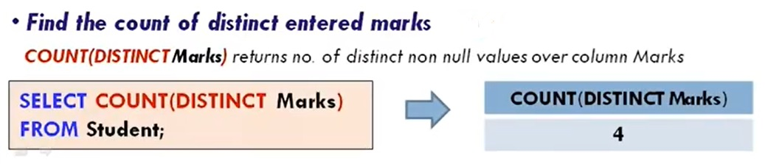
Example : Count Function

Slide 10
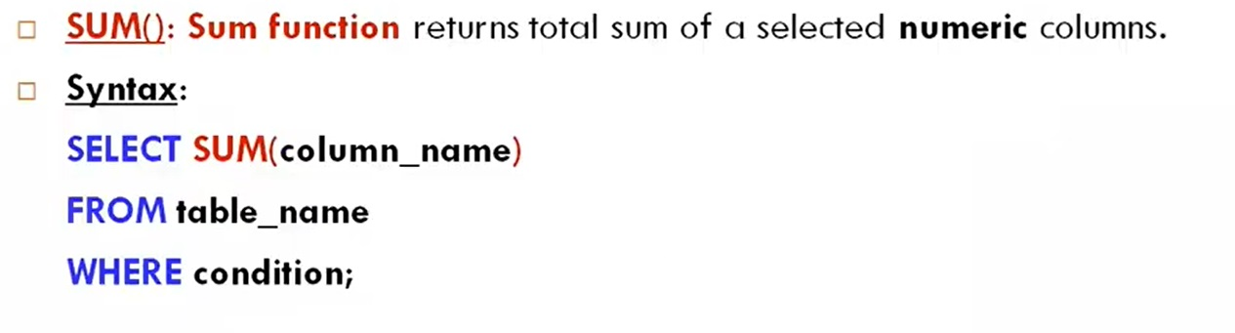
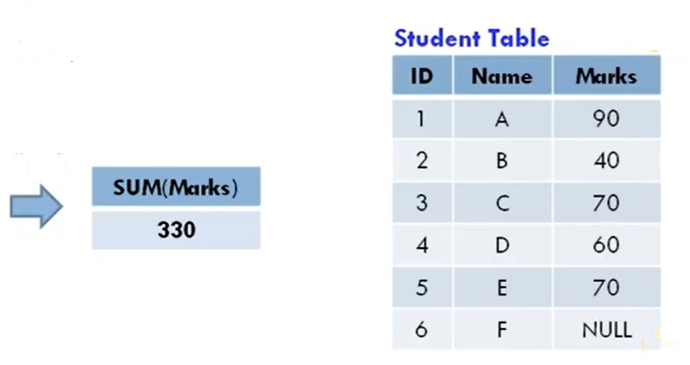
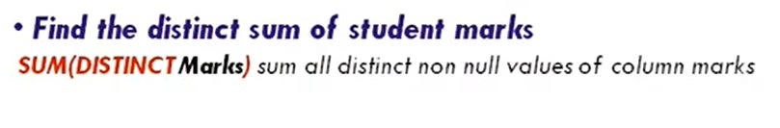
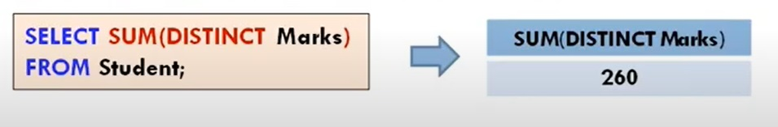
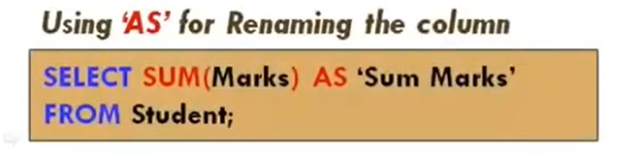
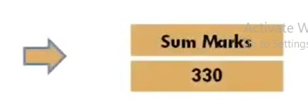
SUM () Function

Slide 11
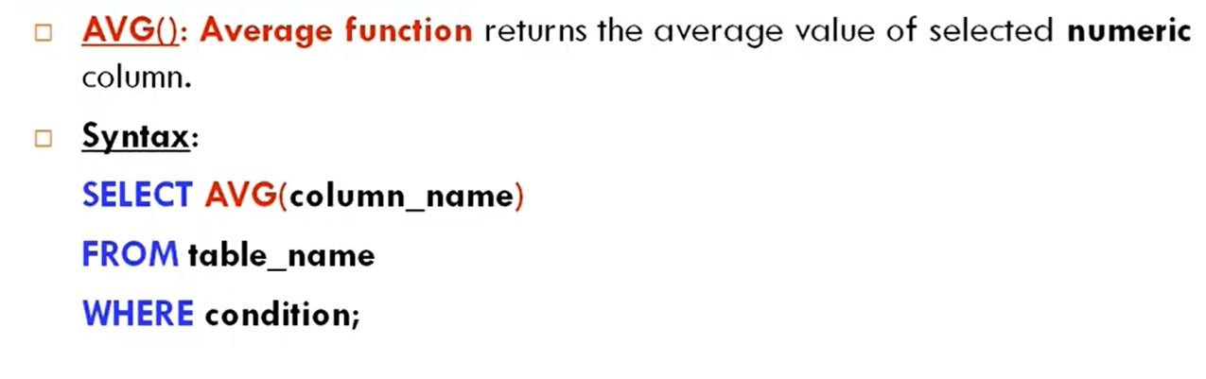
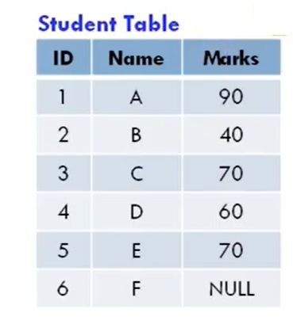
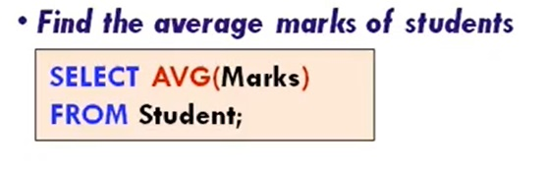
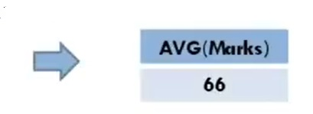
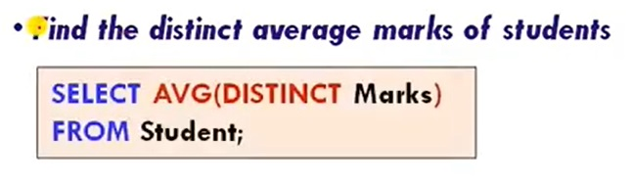
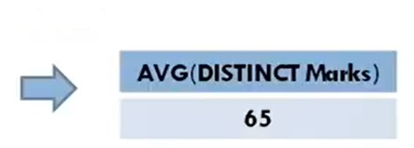
AVG () Function

Slide 12
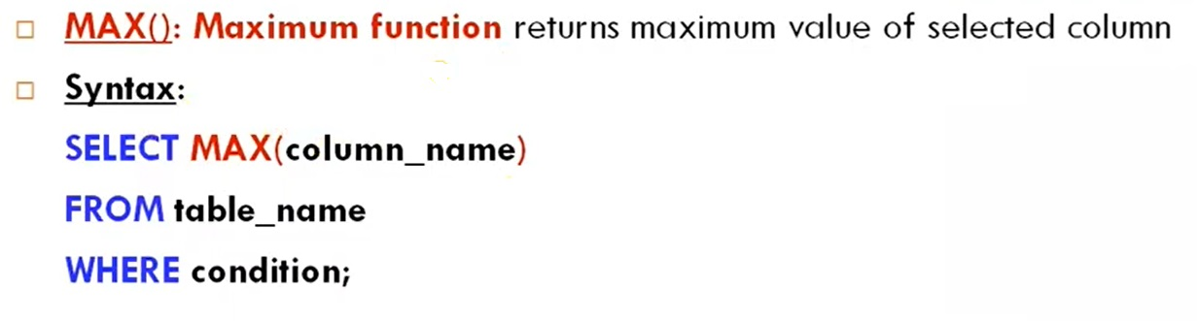
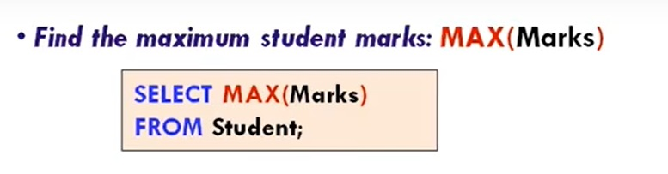
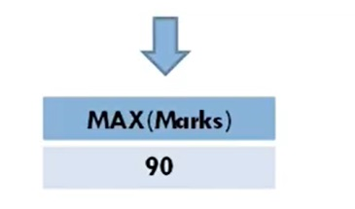
MAX() Function

Slide 13
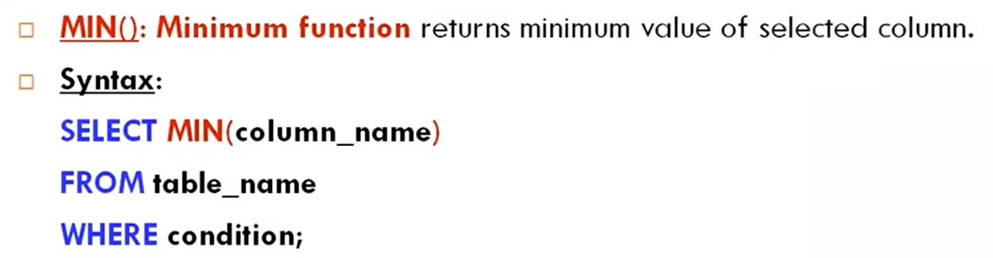
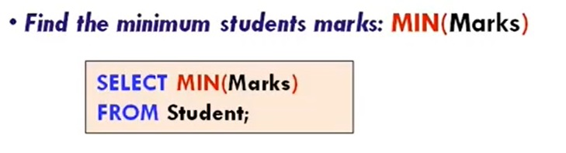
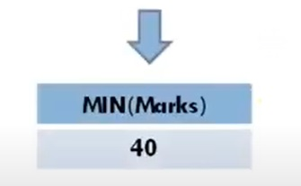
MIN() Function

Slide 14
Exercise – Aggregate Functions
Let's assume the table is called Sales with the following columns:
SalesID (Primary Key)
Product (VARCHAR)
Category (VARCHAR)
Quantity (INT)
Price (DECIMAL)
SaleDate (DATE)

Slide 15
Exercise – Aggregate Functions
What is the total revenue generated?(Use SUM(Quantity * Price))
How many products have been sold in total?(Use SUM(Quantity))
What is the average price of products?(Use AVG(Price))
How many unique product categories exist?(Use COUNT(DISTINCT Category))
What is the highest price of a product in the table?(Use MAX(Price))
What is the lowest price of a product in the table?(Use MIN(Price))
What is the average quantity sold per transaction?(Use AVG(Quantity))
How many total sales records are there in the table?(Use COUNT(SalesID) or COUNT(*))
What is the total revenue for each product category?(Use SUM(Quantity * Price) grouped by Category)
What is the average price of products in each category?(Use AVG(Price) grouped by Category)
Which category has the highest total revenue?(Use SUM(Quantity * Price) with GROUP BY and ORDER BY DESC)
What is the total quantity sold for each product?(Use SUM(Quantity) grouped by Product)
What is the maximum quantity sold in a single transaction?(Use MAX(Quantity))
What is the total revenue for a specific product, e.g., "Laptop"?(Use SUM(Quantity * Price) with a WHERE Product = 'Laptop')

Slide 16
Thank You

